Slide 1

RAMSHA DAUDPOTA
19SW50
My career story
Switching to DevOps

Slide 2
LIST OF CONTENT
04
BEGINNING OF FIELD
which field I chose in the start?
05
06-09
10
11-12
DEVOPS INTRO
what is devops?
SWITCHING TO DEVOPS
why did I shift my career field ?
SCOPE
scope of devops in the market
PROS AND CONS
benefits and its drawbacks

Slide 3
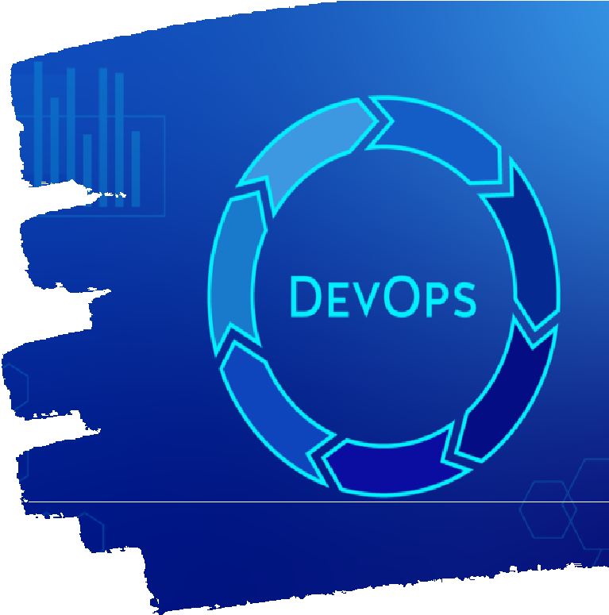

WELCOME TO MY CAREER STORY
'Hi I am Ramsha, a beginner in DevOps field.
Change can be scary at the best of times, but rarely will you find someone who made a big change in their life or career that regrets it. Even when unexpected events force us to make reluctant changes, eventually over time what seemed like a terrible situation invariably leads to greater things.'
anonymous -
LETS GET STARTED

Slide 4



BEGINNNING OF FIELD
I first started my career in web development and did a few internships in front-end as well but with time I found that development is not my field as I am not a coding kinda person so I wanted to shift to another field and I moved on to graphic designing but it didn't feel tempting to me as I was more focused on involving in a field that has a huge scope in the market as well as huge income. so I was still struggling between web and graphics, then in 3rd-year, sir Zubair taught us DevOps, which was a life-changing opportunity for me and guess what I availed it and start learning it on my own pace and still I continuing it and will be doing more of it in the future

Slide 5
WHAT IS DEVOPS
HOW DEVOPS WORKS
Under a DevOps model, development and operations teams are no longer “siloed.” Sometimes, these two teams are merged into a single team where the engineers work across the entire application lifecycle, from development and test to deployment to operations, and develop a range of skills not limited to a single function.
In some DevOps models, quality assurance and security teams may also become more tightly integrated with development and operations and throughout the application lifecycle. When security is the focus of everyone on a DevOps team, this is sometimes referred to as DevSecOps.
DevOps is the combination of cultural philosophies, practices, and tools that increases an organization’s ability to deliver applications and services at high velocity: evolving and improving products at a faster pace than organizations using traditional software development and infrastructure management processes. This speed enables organizations to better serve their customers and compete more effectively in the market.

Slide 6

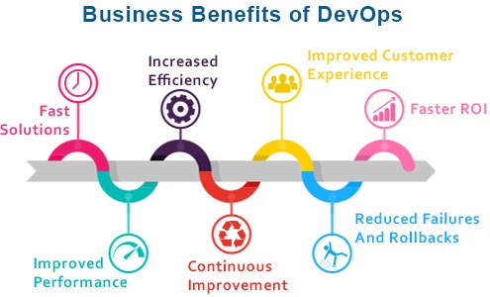
SWITCHING TO DEVOPS
Shifting career to DevOps is not an easy task. It is rather challenging. Though software engineers know coding already but DevOps culture is not just about coding.
As a beginner, read articles related to DevOps, visit various sites or see videos that would help you to understand the framework of the culture. Moreover, apply to different companies (that are using the culture of DevOps)as DevOps not as a software engineer.

Slide 7
DevOps is a challenging task that can be summarized by saying:
It is all about learning the DevOps culture and framework rather than tools. Secondly it is not all about automation. DevOps engineers are successful in their lives if basic knowledge of programming and framework both is there. People coming from any department to DevOps should understand what the developers are doing in the development phase and how they are managing the versions of codes, integrating them, deploying them to servers? Once they understand how things are done manually with no automation tools, things will get easier for them. In Addition to this, one can’t become expert in DevOps, if he is not good in operations. Development and Operations are happening side by side and anyone coming from another department should understand this. A DevOps engineer, not only writes codes but he also has to see and manage other tasks.

Slide 8


DEVOPS STARTING
Shifting to DevOps is not that difficult for a programmer/developer but it can be a bit challenging because you have a huge variety of operations to perform as a DevOps Engineer.
I completed one masterclass in DevOps called DevOps Beginners to Advanced | Decoding DevOps with Projects. This course covers all the essential tools and techniques that you need to learn to move to DevOps/Cloud Engineering.
When I first started this masterclass I got confused because there were so many new concepts and a bunch of tools that I needed to learn that it became a little overwhelming. So I decided to cover each concept in the following order.
UNDERSTANDING DIFFERENT OS CONCEPTS:
SOME NETWORKING CONCEPTS PROCESS MANAGEMENT
, LEARN TO LIVE IN THE TERMINAL, LEARNING TEXT MANIPULATION COMMANDS, LEARNING PROCESS MONITORING COMMANDS
LEARNING SOME BASH SCRIPTING LEARNING SYSTEM PERFORMANCE COMMANDS
LEARNING INFRASTRUCTURE AS CODE
LEARNING TERRAFORM FOR INFRASTRUCTURE PROVISIONING. LEARNING ANSIBLE, CHEF, OR PUPPET FOR CONFIGURATION MANAGEMENT
LEARNING CI/CD TOOLS (JENKINS AND GITLAB IS RECOMMENDED) LEARNING CONTAINERIZATION AND CONTAINER ORCHESTRATION

Slide 9



3. Learning any one cloud computing service. It is entirely up to you but I would recommend learning any one of the following
AWS (Amazon Web Services) Microsoft Azure
Google Cloud Platform
Each concept listed here has a separate career in itself. For example, a system administrator (Linux) is a separate career as compared to container orchestration using Kubernetes. But as a DevOps engineer, you must have the basic knowledge of all the areas I mentioned so that you are fully gripped to start your career as a DevOps engineer. I took a full month to cover every concept by learning and then applying the concepts in hands-on projects. If you don’t practice, you will forget because there are a lot of concepts and tools to learn and apply. It's overwhelming at the start but consistency is the key. Be consistent and stick to one masterclass or roadmap from beginning to end everything will come together.

Slide 10


DEVOPS SCOPE
25
20
15
DevOps has a great and promising future. The practical applications of DevOps are increasing day 10 by day. Let’s discuss the future of DevOps in different areas of the IT industry and where most opportunities lie
5
There is a growing market for DevOps in today’s time the market is expected to reach US$ 287.9 billion by 2026 (Source). There are various roles and responsibilities that are available in the market for DevOps professionals such as DevOps Engineer, Platform Engineer, Building Engineer, Platform Engineer, etc. Devops engineer salary in the market is The salary of a DevOps engineer ranges from 4.2 lakhs to 12.3 lakhs and the average salary is 6.0 LPA (Source).
DEVOPS IN THE SECURITY FIELD
AI/ML IN THE DEVOPS FRAMEWORK
AUTOMATION FOR EVERY COMPANY
CONTAINER TECHNOLOGY
PLATFORM AS A SERVICE (PAAS)
DEVOPS AND FOCUS ON INTEGRATION BETWEEN EDGE SERVICES AND MANY MORE
0
2008 2010 2014 2018
GROWTH INTEREST
2022

Slide 11



PROS OF DEVOPS
Faster product release and faster time to market
Higher productivity Process efficiency
Shortened production cycles Better operational support Engaged and motivated staff Better Customer experience management
Clear product vision within the team Increased deployment success rates Increased product quality
Better team efficiency
Improved flexibility and support Reduced chance of product failure Cross-skilling and self-improvement

Slide 12


CONS OF DEVOPS
Production environment in the cloud makes an enterprise infrastructure test purposes complex and leads to compatibility issues. In-depth understanding required to handle the integration, infrastructure, and orchestrating the workflow. The DevOps actually gives importance to speed over security.
Demands proper mindset across the company Lowered business security by outsourcing the DevOps operations
Dealing with the legacy system is a challenge Practicing security for CI/CD is a separate affair
Getting the right pool of DevOps expertise is a challenge Challenges with the number of tools and switching tools Transition challenges (organizational and technical)

Slide 13
THANKS FOR READING

